Slide 1


5005CEM Lecture 4b: Summary Statistics of Two Variables
School of Computing, Mathematics and Data Science Coventry University
5005CEM Data Science 2022/23 Semester 2

Slide 2
Recap
Visualisation of two categorical variables: barchart (stacked/grouped/back-to-back)
Visualisation of one categorical variable and one quantitative variable: side-by-side plots (boxplot/violin plot/histogram)
Visualisation of two quantitative variables: scatterplot
Visualisation of multivariate data: bubble plot, …

Slide 3
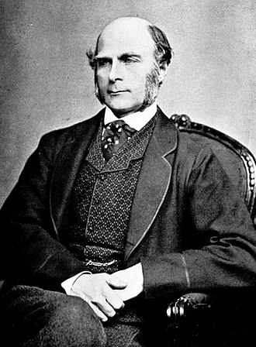
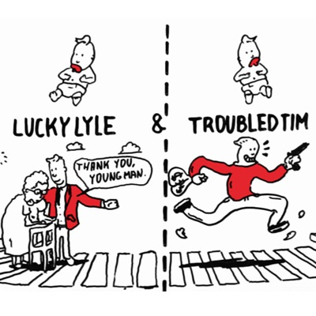
Sir Francis Galton (1822–1911)
Studied inherited traits, e.g., height.
Coined the phrase “nature versus nurture”.
Devised the first weather map.
Invented the Galton whistle for testing hearing.
Created the statistical concepts of correlation and regression when investigating genetics and inheritance.
Notes:
Image from: https://www.mn.uio.no/ibv/english/research/sections/bmb/events/2016-05-12.html

Slide 4
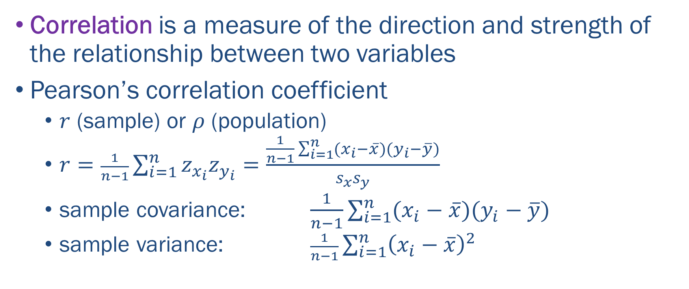
Summary Statistics of Two Quantitative Variables
Correlation is a measure of the direction and strength of the relationship between two variables
Pearson’s correlation coefficient
$r$ (sample) or $ρ$ (population)
$r=\frac{1}{n−1}\sum_{i=1}^{n}{z_{x_{i}}z_{y_{i}}}=\frac{\frac{1}{n−1}\sum_{i=1}^{n}{(x_{i}−\overline{x})(y_{i}−\overline{y})}}{s_{x}s_{y}}$
sample covariance: $\frac{1}{n−1}\sum_{i=1}^{n}{(x_{i}−\overline{x})(y_{i}−\overline{y})}$
sample variance: $\frac{1}{n−1}\sum_{i=1}^{n}{{\left(x_{i}−\overline{x}\right)}^{2}}$
Notes:
Karl Pearson (1957-1936) developed what is now called Pearson’s correlation coefficient.

Slide 5
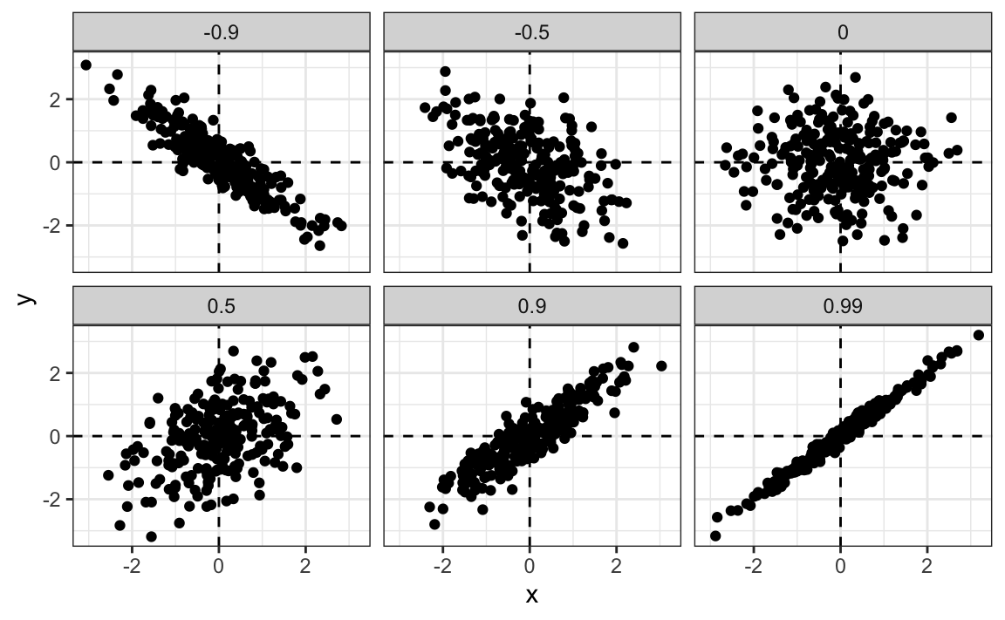
Summary Statistics of Two Quantitative Variables
Notes:
Image from: https://rafalab.github.io/dsbook/regression.html

Slide 6
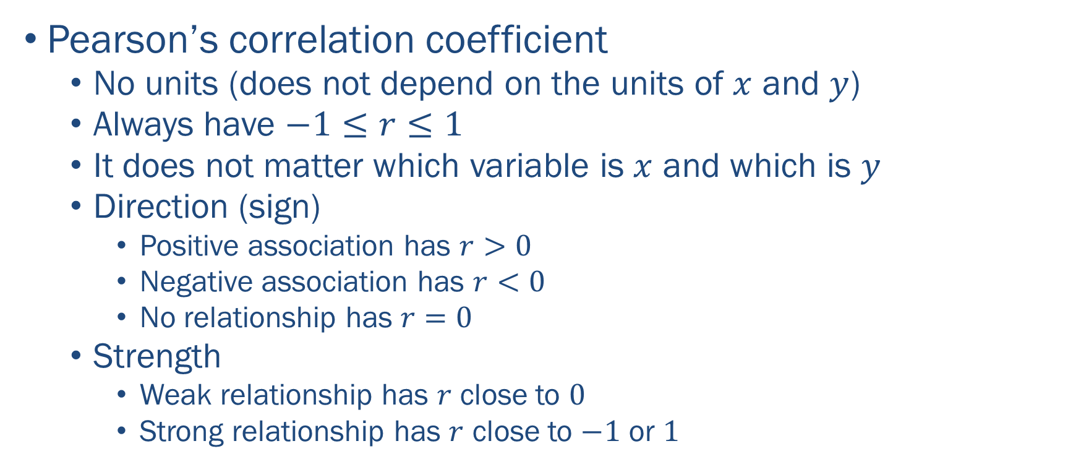
Summary Statistics of Two Quantitative Variables
Pearson’s correlation coefficient
No units (does not depend on the units of $x$ and $y$)
Always have $−1≤r≤1$
It does not matter which variable is $x$ and which is $y$
Direction (sign)
Positive association has $r>0$
Negative association has $r<0$
No relationship has $r=0$
Strength
Weak relationship has $r$ close to $0$
Strong relationship has $r$ close to $−1$ or $1$

Slide 7
Summary Statistics of Two Quantitative Variables
Strength
Note: different sources give different descriptions
0-0.2 Very weak
0.2-0.4 Weak
0.4-0.6 Moderate
0.6-0.8 Strong
0.8-1.0 Very strong
WARNING! — Correlation coefficient is NOT robust, i.e., it is sensitive to (bivariate) outliers

Slide 8
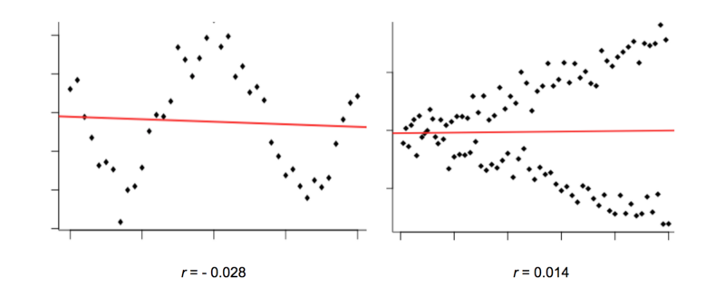
Summary Statistics of Two Quantitative Variables
Warning! — Only use Pearson’s correlation coefficient when there is a linear relationship
confirm with a scatterplot that any relationship is NOT nonlinear
Notes:
Image from: https://www.freecodecamp.org/news/how-machines-make-predictions-finding-correlations-in-complex-data-dfd9f0d87889/

Slide 9
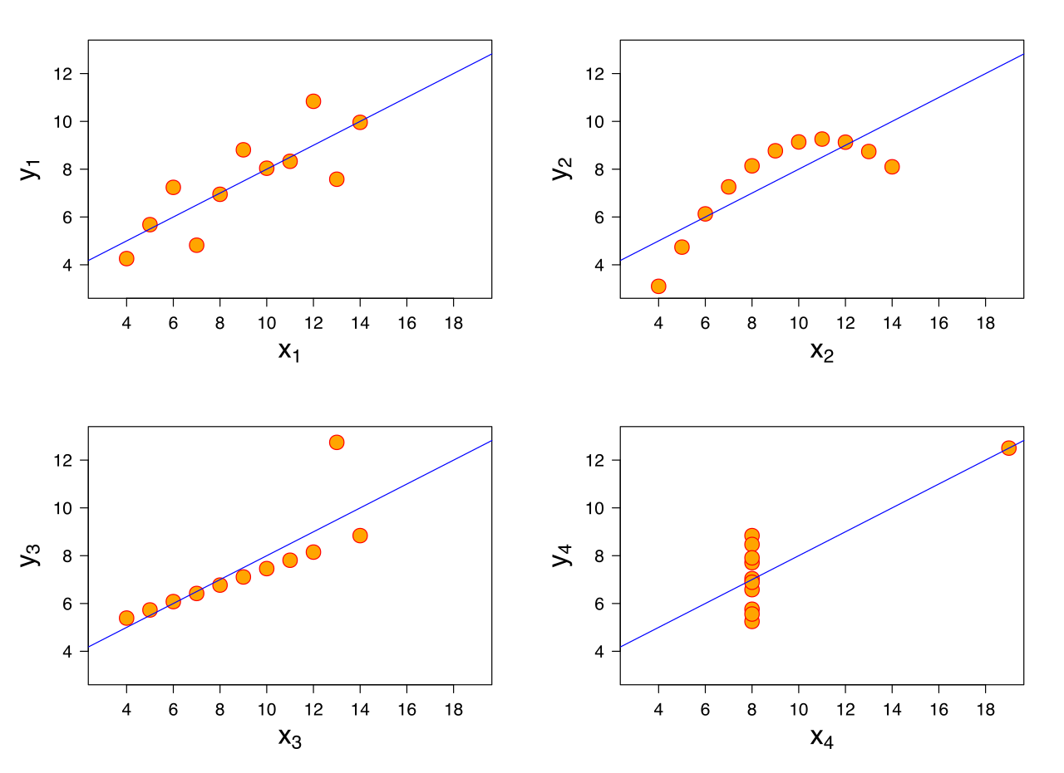
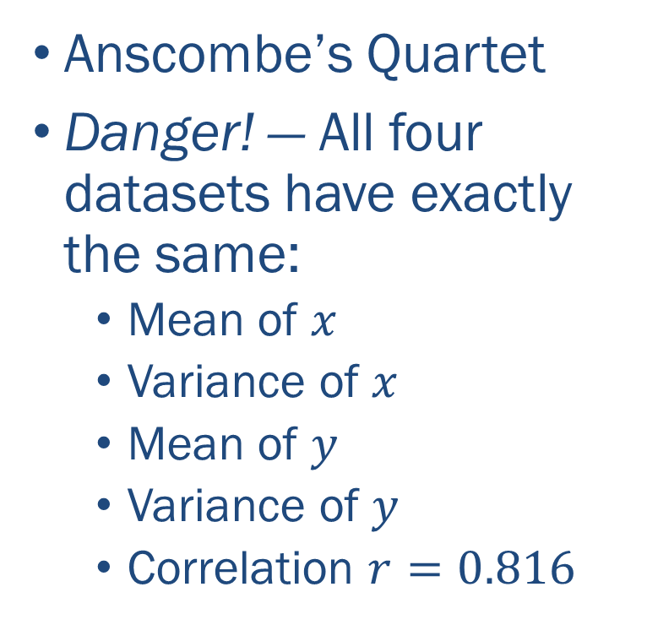
Summary Statistics of Two Quantitative Variables
Anscombe’s Quartet
Danger! — All four datasets have exactly the same:
Mean of $x$
Variance of $x$
Mean of $y$
Variance of $y$
Correlation $r=0.816$
Notes:
Reading: https://en.wikipedia.org/wiki/Anscombe%27s_quartet

Slide 10
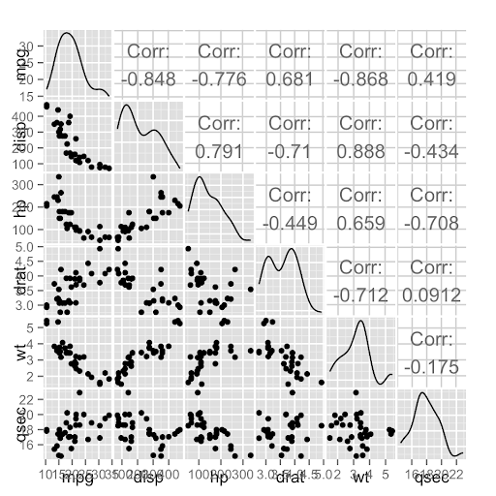
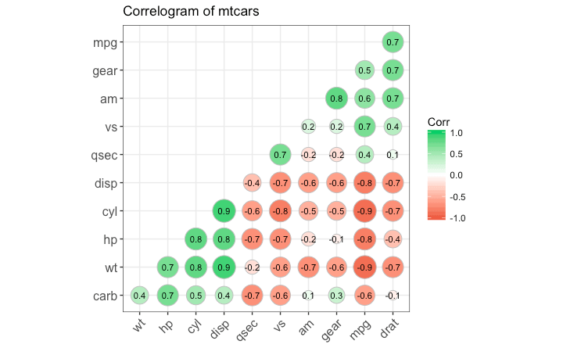
Summary Statistics of Multivariate Data

Slide 11
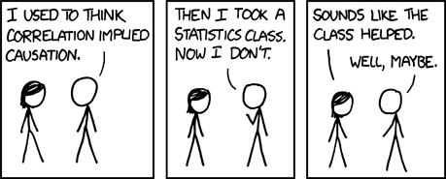
Correlation vs Causation
If A and B are strongly correlated, does A cause B?
Warning! — Correlation does not imply causation
Notes:
Reading: https://en.wikipedia.org/wiki/Correlation_does_not_imply_causation
Image from: https://www.xkcd.com/552/

Slide 12
Correlation vs Causation
Latin phrase: “cum hoc ergo propter hoc” (“with this, therefore because of this”)
The rooster crows every morning, therefore the rooster causes the sun to come up.
Hospitals are full of sick people, therefore hospitals make people sick.
Possible explanations
A third event (or variable) is the real source of the correlation, e.g., shoe size is positively correlated with handwriting skill.
The direction of causation may be reversed.
The correlation is purely a coincidence.
Notes:
Reading: https://en.wikipedia.org/wiki/Correlation_does_not_imply_causation
Image from: https://www.xkcd.com/552/

Slide 13
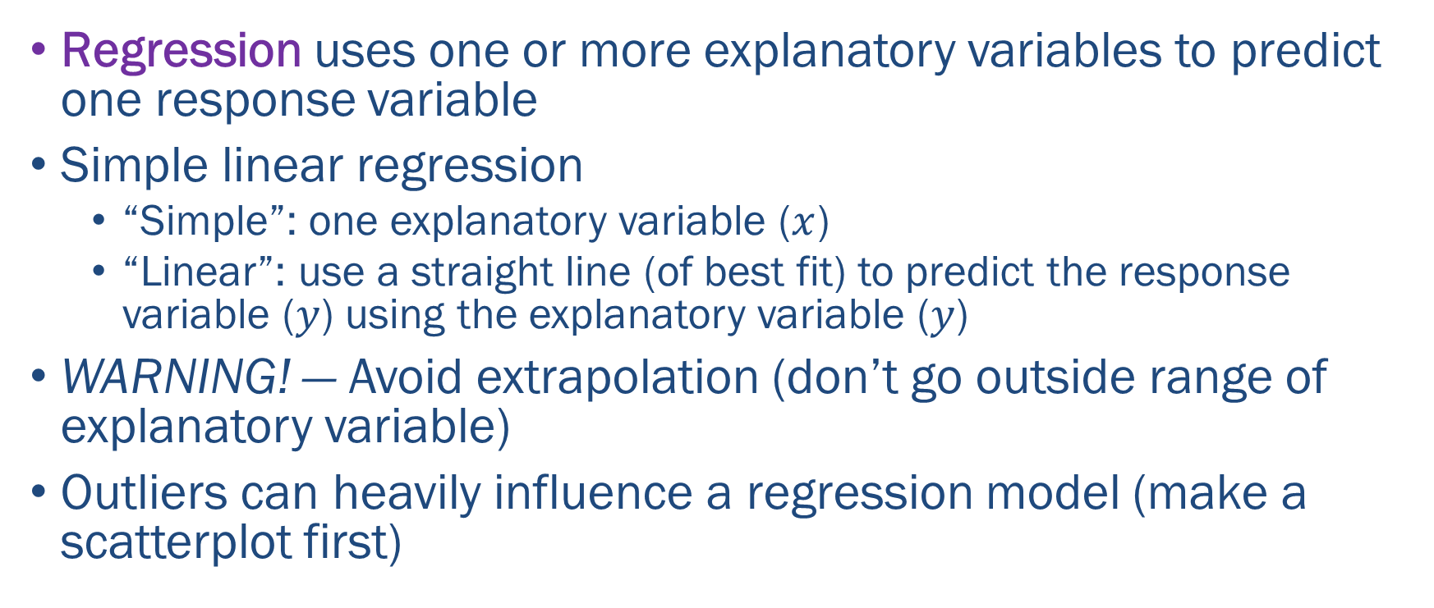
Statistical Modelling of Two Quantitative Variables
Regression uses one or more explanatory variables to predict one response variable
Simple linear regression
“Simple”: one explanatory variable ($x$)
“Linear”: use a straight line (of best fit) to predict the response variable ($y$) using the explanatory variable ($y$)
WARNING! — Avoid extrapolation (don’t go outside range of explanatory variable)
Outliers can heavily influence a regression model (make a scatterplot first)

Slide 14
Summary
For two quantitative variables, Pearson’s correlation coefficient is a one number summary statistic of the (linear) relationship between the two variables.
Danger! — Very different datasets might have the same summary statistics.
For multivariate data, a scatter matrix gives scatterplot and correlation coefficient for each pair of variables.
Correlation does not imply causation.

Slide 15
Class Discussion Questions
Consider the quotes below and discuss whether or not they are relevant to EDA.
“Correlation is not cause, it is just a ‘music of chance’.” — Siri Hustvedt
“There’s no correlation between accents and intelligence.” — David Crystal

Slide 16
Class Discussion Questions
A 2013 journal article published in Nutrition and Cancer found a negative correlation between coffee consumption and breast cancer in women. Can we conclude that coffee protects against cancer?
Notes:
Article: https://pubmed.ncbi.nlm.nih.gov/23530639/

